Slide 1
WEB-BASED ACCREDITATION MANAGEMENT AND READINESS ASSESSMENT SYSTEM FOR STI WEST NEGROS UNIVERSITY
MASTER IN INFORMATION TECHNOLOGY
ENGR. CLYDE TABURADA
MIT Candidate (Master in Information Technology)
College of Information and Communications Technology
STI West Negros University, Bacolod City

Slide 2
General Objectives:
MASTER IN INFORMATION TECHNOLOGY
To design, develop, and evaluate a Web-Based Accreditation Management and Readiness Assessment System for STI West Negros University that centralizes evidence mapping, automates PACUCOA-compliant readiness scoring, provides what-if simulation, and tracks post-visit compliance.
Specific Objectives:
1. Build an Evidence Management module to centralize exhibit mapping and validate file formats, effective dates, and required document counts.
2. Implement an automated Readiness Scoring Engine computing ratings using the PACUCOA 30-weight formula and dual-constraint floor rules.
3. Provide an isolated What-If Simulation Sandbox to forecast accreditation readiness without altering live production data.
4. Incorporate a Post-Visit Compliance Tracking module recording recommendations, action plans, and verification exhibits.
5. Enforce role-based access control and separation of duties with a database-level self-verification block.
6. Evaluate software quality against ISO/IEC 25010 across eight software quality characteristics with 20 respondents (15 users and 5 IT experts).

Slide 3
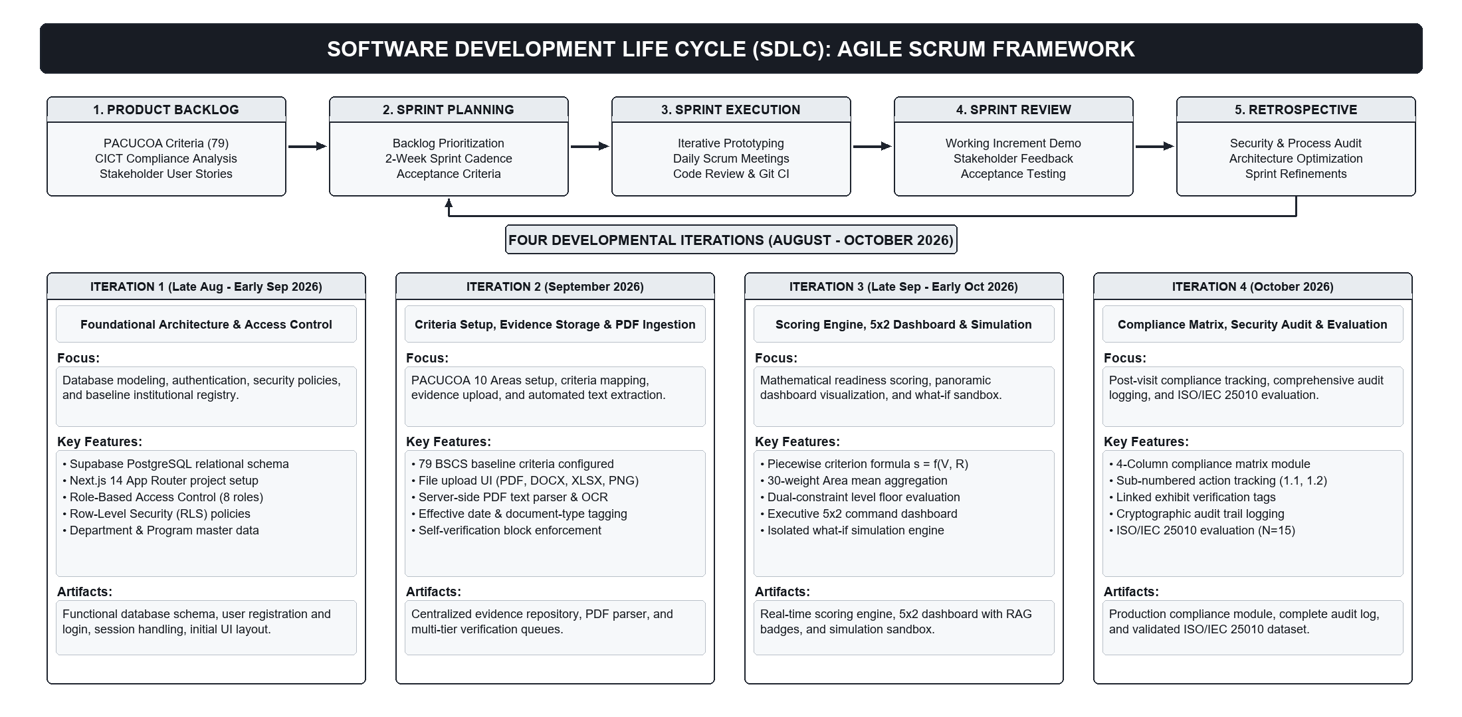
System Design
MASTER IN INFORMATION TECHNOLOGY
Figure 2. Software Development Life Cycle (SDLC) Framework (Agile Scrum with 4 Sprints)

Slide 4
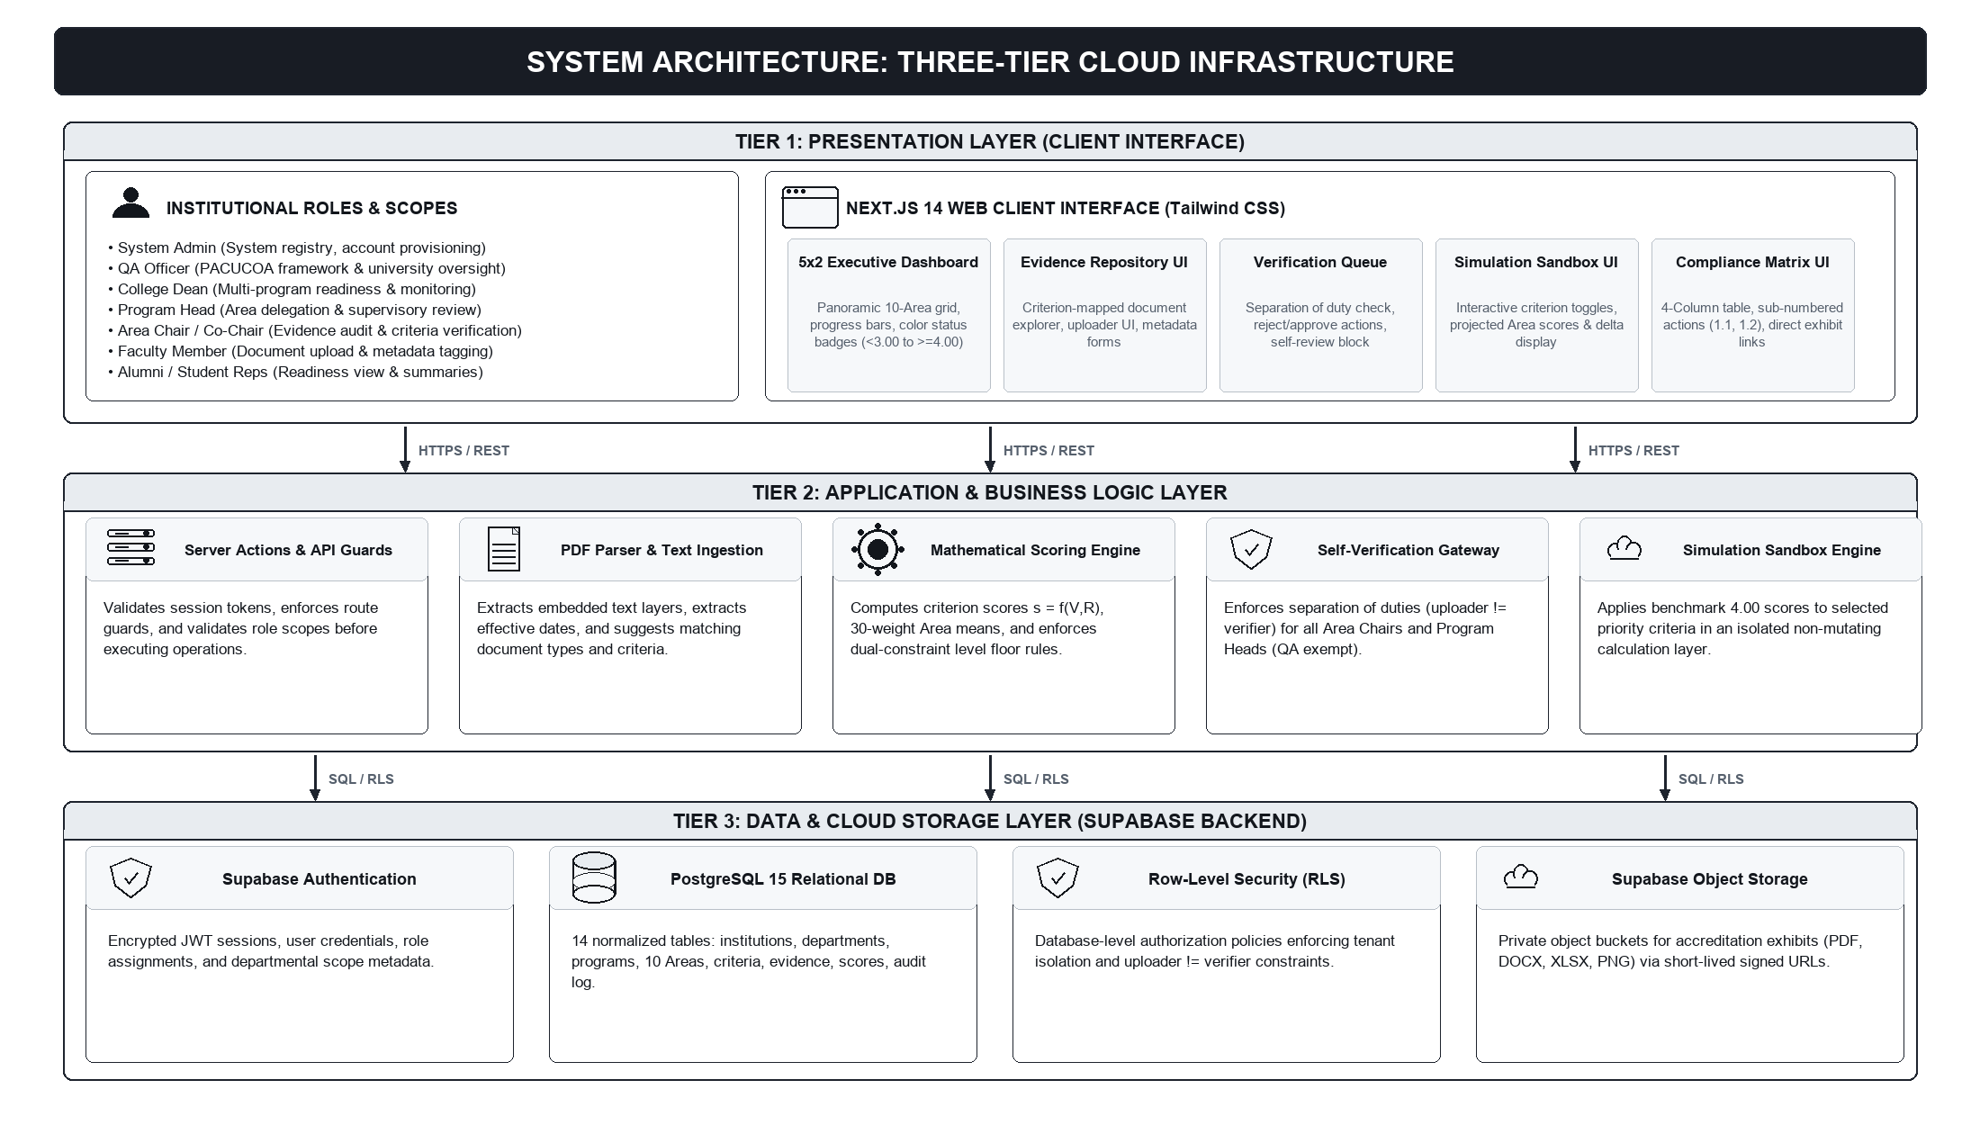
System Design
MASTER IN INFORMATION TECHNOLOGY
Figure 3. System Architecture of the Web-Based Accreditation Management System

Slide 5
System Design
MASTER IN INFORMATION TECHNOLOGY
List of Hardware and Software Components
Category / Tier | Technology / Specification | Functional Role in Platform
Presentation Tier | Next.js 14, React 18, TypeScript, Tailwind CSS, Lucide Icons | Delivers responsive UI, QA Configuration, Executive Dashboard, and Simulation Sandbox.
Backend & Database | Supabase BaaS, PostgreSQL 15, Row-Level Security (RLS) | Manages relational schema, automated scoring engine, and role-based data isolation.
Storage & Processing | Supabase Storage, Server-side PDF Text Extraction | Enforces encrypted exhibit storage, signed URLs, and text-layer metadata extraction.
Security & Access | Supabase Auth, JWT Tokens, Role-Based Access Control | Enforces separation of duties across QA Officer, Admin, Dean, Program Head, and Faculty.
Hardware Requirements | Host: Cloud Server (4GB RAM, 20GB SSD); Client: 1.6 GHz, 4GB RAM | Cross-browser operation across modern browsers (Chrome, Edge, Firefox) with zero client install.

Slide 6
RESULTS
MASTER IN INFORMATION TECHNOLOGY
Table of the Results of Experts' Evaluation (ISO/IEC 25010 - IT Experts, n = 5)
ISO/IEC 25010 Quality Characteristic | Mean Rating (n = 5) | Verbal Interpretation
1. Functional Suitability | 4.10 | Very Highly Acceptable
2. Performance Efficiency | 4.50 | Very Highly Acceptable
3. Compatibility | 4.10 | Very Highly Acceptable
4. Usability | 4.30 | Very Highly Acceptable
5. Reliability | 4.20 | Very Highly Acceptable
6. Security (Highest Rated) | 4.90 | Very Highly Acceptable
7. Maintainability | 4.60 | Very Highly Acceptable
8. Portability | 4.50 | Very Highly Acceptable
OVERALL EXPERTS' GRAND MEAN | 4.40 | Very Highly Acceptable
Key Insight: External IT experts rated Security highest at 4.90, confirming robust access control, data encryption, and self-verification isolation.

Slide 7
RESULTS
MASTER IN INFORMATION TECHNOLOGY
Table of the Results of User Acceptance (ISO/IEC 25010 - Institutional Users, n = 15)
ISO/IEC 25010 Quality Characteristic | Users (n = 15) | Combined (N = 20) | Verbal Interpretation
1. Functional Suitability | 4.84 | 4.66 | Very Highly Acceptable
2. Performance Efficiency | 4.78 | 4.71 | Very Highly Acceptable
3. Compatibility | 4.80 | 4.63 | Very Highly Acceptable
4. Usability | 4.87 | 4.73 | Very Highly Acceptable
5. Reliability | 4.82 | 4.67 | Very Highly Acceptable
6. Security | 4.89 | 4.89 | Very Highly Acceptable
7. Maintainability | 4.77 | 4.73 | Very Highly Acceptable
8. Portability | 4.85 | 4.76 | Very Highly Acceptable
USERS' GRAND MEAN | 4.83 | — | Very Highly Acceptable
OVERALL COMPOSITE GRAND MEAN | — | 4.72 | Very Highly Acceptable
Key Insight: Institutional users (1 QA Officer, 1 Dean, 2 Program Heads, 11 Faculty) gave an overall 4.83 rating, highlighting Usability (4.87) and Security (4.89).

Slide 8
Conclusion:
MASTER IN INFORMATION TECHNOLOGY
1. Centralized Accreditation: Successfully migrated physical paper binders into a unified, secure digital repository mapped directly to PACUCOA criteria trees.
2. Automated Readiness Engine: Eliminated manual scoring errors by automating the 30-weight formula and dual-constraint floor rules for real-time compliance tracking.
3. Verification Integrity: Guaranteed institutional defensibility and separation of duties through database-level self-verification isolation and preview enforcement.
4. Very Highly Acceptable Quality: An ISO/IEC 25010 evaluation across 20 respondents (4.83 users, 4.40 IT experts, 4.72 composite grand mean) confirms the system is robust, secure, and ready for deployment.

Slide 9
Recommendations:
MASTER IN INFORMATION TECHNOLOGY
1. Institutional Deployment: Operationalize the system for BSCS and expand university-wide across all CICT academic programs at STI West Negros University.
2. Continuous Exhibit Submission: Mandate regular semester-end digital exhibit uploads by faculty to sustain year-round PACUCOA reaccreditation readiness.
3. Campus API Integration: Establish secure API connections with STI WNU's Student Information System (SIS), LMS, and HRIS to automate credentials ingestion.
4. Multi-Accreditor Support: Extend the configurable scoring framework to accommodate other accrediting agencies such as PAASCU, ALCUCOA, and CHED standards.

Slide 10
References:
MASTER IN INFORMATION TECHNOLOGY
1. Commission on Higher Education. (2019). Policies and guidelines on the grant of autonomous and deregulated status to private higher education institutions (CMO No. 12, s. 2019). CHED.
2. Conchada, M. I., & Tiongco, M. M. (2015). A review of the accreditation system for Philippine higher education institutions (PIDS Discussion Paper No. 2015-30). PIDS.
3. International Organization for Standardization. (2011). Systems and software engineering -- SQuaRE -- System and software quality models (ISO/IEC 25010:2011). ISO.
4. Philippine Association of Colleges and Universities Commission on Accreditation. (2023). Manual of accreditation (Rev. ed.). PACUCOA.

